Slide 1
Individual Technical Presentation: Magnetic Resonance
Caleb Rozenboom

Slide 2
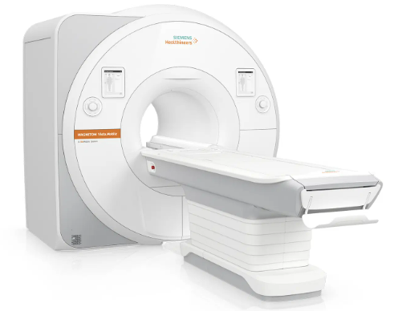
Introduction
MRI changed the medical industry
Technology advanced in quantum physics, super conductors, and computer science

Slide 3
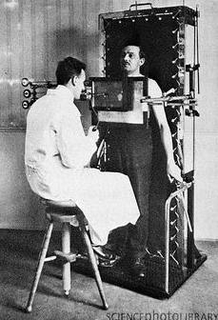
History of the MRI
Harmful X-rays
Absorption of x-ray beams
Low-resolution ultrasound
Sound waves bounce off densities
Flat 2d
MRI better imaging and contrast with less risk
Takes longer and expensive

Slide 4
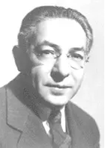
History of the MRI
Developed by Isidor Isaac Rabi (1898-1988) [1]
Worked with Bohr, Pauli, Heisenberg
Discovered magnetic resonance
Nobel Prize in 1944
First images in 1970
First human subject in 1977
After being imaged he said, “It was eerie. I saw myself in that machine, I never thought my work would come to this.”

Slide 5
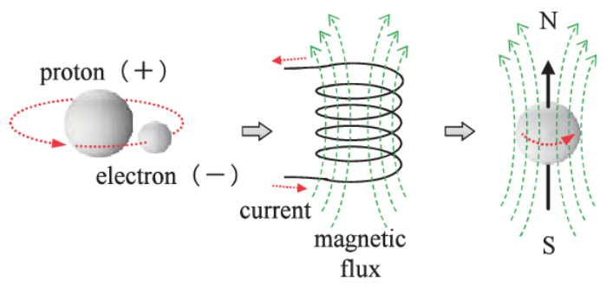
Hydrogen Atom
Hydrogen atoms in body
Bar magnets
Evenly distributed probability
Net magnetization vector
Parallel and anti-parallel

Slide 6
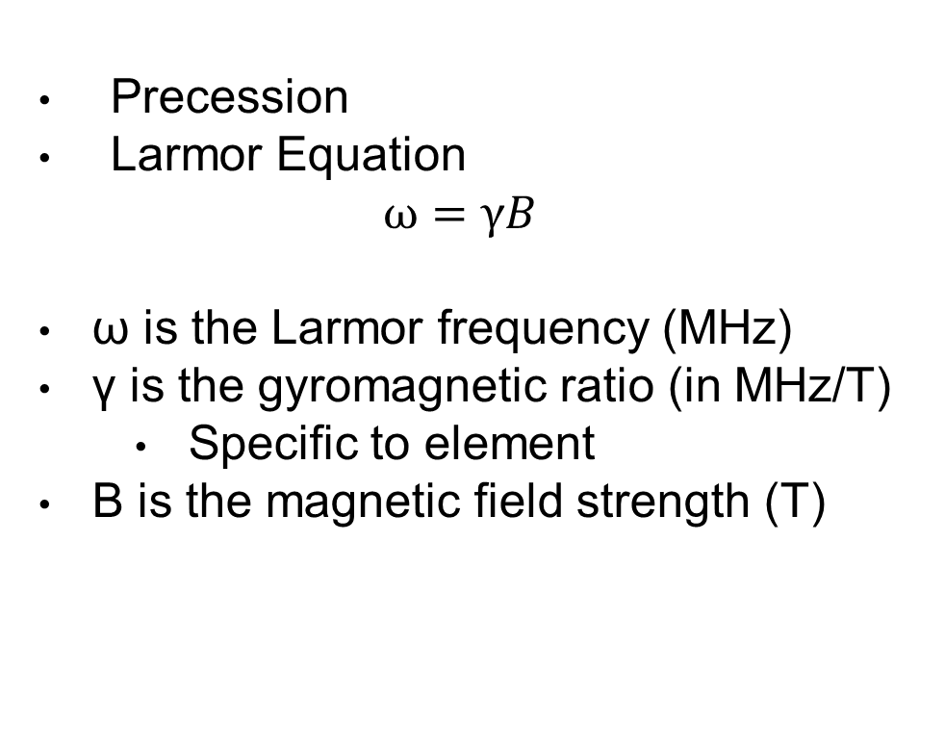
Nucluear Spin
Precession
Larmor Equation
$$ω=γB$$
ω is the Larmor frequency (MHz)
γ is the gyromagnetic ratio (in MHz/T)
Specific to element
B is the magnetic field strength (T)

Slide 7
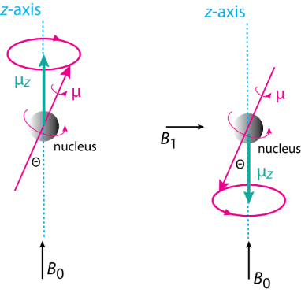
Radiofrequency Pulse
RF (B1 in right picture)
Changes longitudinal magnetization vector (LMV)
Temporarily aligns in phase
Angle depends on intensity
Sends radiofrequency back

Slide 8
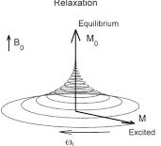
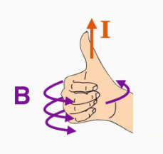
Relaxation
Sends 90 degree RF
Transverse Magnetization Vector
Free induction decay
T1 time:
63% of LMV has been recovered [2]
T2 time:
63% of TMV has been lost [2]
T1 and T2 are unique to different tissues
T1 fat and T2 water

Slide 9
Free Induction Decay Caveats
Applies to 90 degree only
Signal decays rapidly
Requires fast scanner
T2* constant dephasing
Not actually uniform
Experience B field differently
Signal dropout
How to fix? 180 RF correction pulse
More energy: echo
Done over and over until no more energy

Slide 10
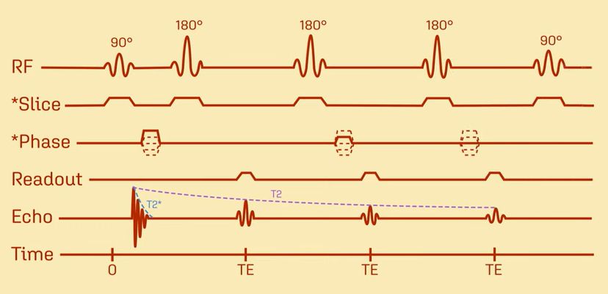
Spin Echo Sequence

Slide 11
References
[1] July, 1977: MRI Uses Fundamental Physics for Clinical Diagnosis https://www.aps.org/publications/apsnews/200607/history.cfm#:~:text=The%20first%20images%20were%20produced,soft%20tissues%20like%20the%20brain.
[2] Questions and Answers in MRI https://mriquestions.com/opposite-effects-uarrt1-uarrt2.html
[3] T1-weighted and T2-weighted MRI image synthesis with convolutional generative adversarial networks https://www.ncbi.nlm.nih.gov/pmc/articles/PMC8086713/#:~:text=T1%2Dweighted%20MRI%20enhances%20the,MRI%20image%20analysis%20and%20diagnosis.

